Slide 1
Mountain Ski Resort
Capstone Project II by Liudmila Khalitova
Supervisor Varun Bhatia
Springboard 2020
Notes:
Highlight keywords, add recommendations, add subse

Slide 2
PROBLEM STATEMENT
CURRENT PRICING
MAKING CHANGES
Assessing the adequacy of the current pricing strategy
Analyzing potential changes in the resort’s infrastructure from revenue generation perspective.
COMPETITVE ADVANTAGES
Discovering key features influencing ticket price
The purpose of this project is to provide data-driven guidance on how to select a better value for Big Mountain Resort ticket price and test potential scenarios for implementing changes that would either cut operating costs or allow charging premium for tickets.

Slide 3
RESEARCH QUESTIONS
Is the resort's current pricing strategy to base their pricing in the market's average adequate?
What resorts features people are willing to pay extra for?
Where does Big Mountain Resort stand on these features, compared to competitors, and how much it should be charging per ticket?
How the proposed changes in the infrastructure would affect revenue?

Slide 4
The approach
DATA WRANGLING
Cleaning and transforming the dataset
EXPLORATORY DATA ANALYSIS
Spotting outliers, observing relationships between variables
PREPROCESSING AND TRAINING
Preparing the dataset and training models
MODELING
Model deployment
EXTRACTING INSIGHTS
Preparing recommendations for leadership

Slide 5
Recommendations and key findings
Without information on how much money closing a run would save, it is difficult to make exact recommendations on how many of them could be closed. One can be closed without affecting ticket price or revenue, closing more would depend on whether the resulting savings would be greater than expected losses in revenue.
The resort can increase ticket price by at least $3 without making any improvements; adding one run, increasing the vertical drop by 150 feet, and installing an additional chair would allow for an additional price increase in $1.99 and additional $3,474,638 in revenue.

Slide 6
Modeling results and analysis
Is the resort's current pricing strategy to base their pricing in the market's average adequate?
We first explored what should be considered as 'a market' in the context of out business questions. The data indicated that all US resorts can be included into the definition of market; there were no substantial differences among states. Then we proceeded to testing average market price as a predictor of resorts' ticket price. The result indicated that basing ticket price on the market average would result, on average, in a $19 mismatch. In addition, the model fitted poorly explaining less than 1% of variance in ticket price meaning this is not an adequate strategy.

Slide 7
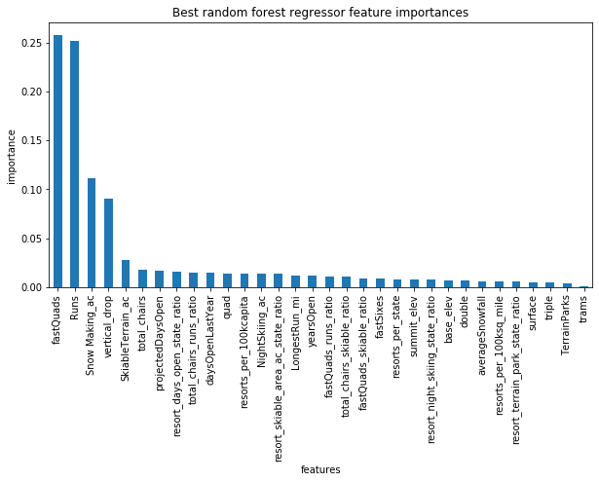
Modeling results and analysis
What resorts features people are willing to pay extra for?
Modeling resort price based off its features seemed to be a better strategy. Our models explained more than 70% in the ticket price. Based on our best fitting model, the following features seemed to be the most important: fast quads, runs, total area covered by snow machines, vertical drop, skiable terrain, and total chairs.

Slide 8
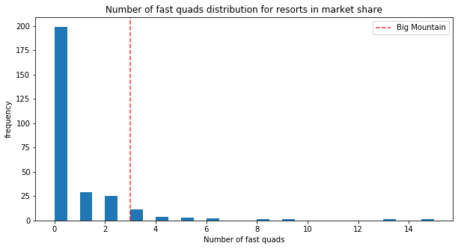
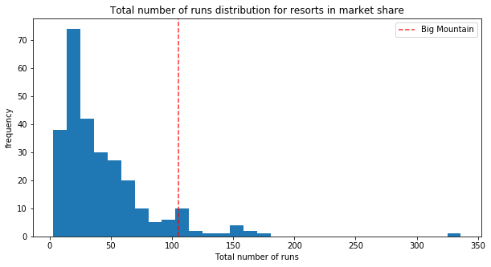
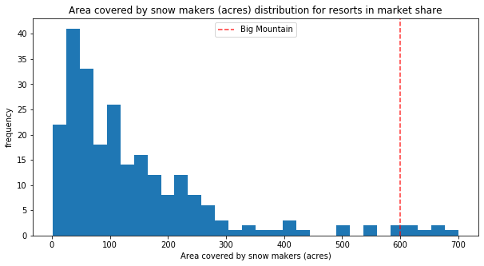
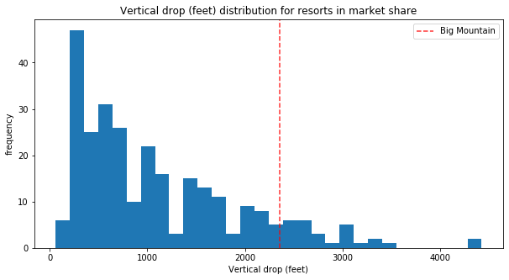
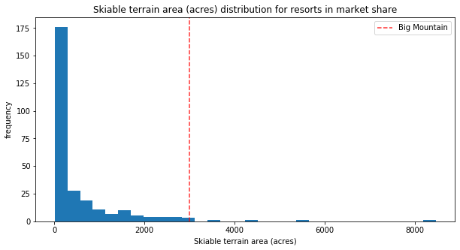
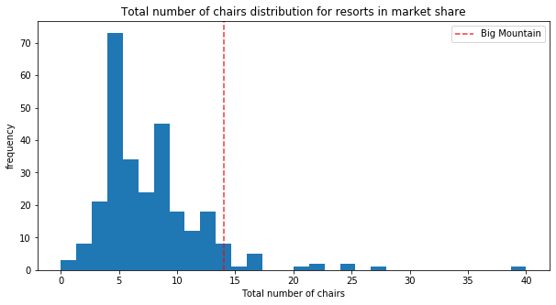
Modeling results and analysis
Where does Big Mountain Resort stand on these features, compared to competitors, and how much it should be charging per ticket?
What resorts features people are willing to pay extra for?
The plots above show resorts' distribution on the key features predicting ticket price. Red line indicates Big Mountain Resort's position in the distribution. The chart suggests that Big Mountain Resort outperforms most competitors on all of these features. Our model suggested that the resort is currently underpricing itself. Big Mountain Resort modelled price is $94.22 whereas it actual price is $81.00. Even with the expected mean absolute error of $10.39, this suggests there is room for at least a $3 increase.

Slide 9
Limitations and conclusions
The analysis is predicated on the assumption that competitors price themselves fairly which is not necessarily the case.
Without information on how much money closing a run would save, it is difficult to make exact recommendations on how many of them could be closed. One can be closed without affecting ticket price or revenue, closing more would depend on whether the resulting savings would be greater than expected losses in revenue.
We might be lacking some information about the infrastructure surrounding the resort. It is possible that customers are willing to pay higher price to stay at resorts with better hotels, dining places or areas that offer other activities, in addition to skiing.

